Slide 1
Software Development Life Cycle Model
Lecturer: Ngo Huy Bien
Software Engineering Department
Faculty of Information Technology
VNUHCM - University of Science
Ho Chi Minh City, Vietnam
nhbien@fit.hcmus.edu.vn

Slide 2

Objectives
To define a SDLM for a project

Slide 3

Contents
Software Requirements.
Software Design.
Software Construction (Implementation).
Software Inspection.
Software Testing.
Software Deployment & Acceptance Testing.
Software Operation & Maintenance.
SDLC Model Definition.
NASA/SEL SDLC Model.

Slide 4

References
NASA (1992). Recommended Approach to Software Development.
University of Southern California (1990). Models of Software Evolution: Life Cycle and Process.
Roger S. Pressman (2010). Software Engineering: A Practitioner’s Approach.
Silvia T. Acuna et al. (1999). A Process Model Applicable to Software Engineering and Knowledge Engineering.
Scott Berkun (2008). Making Things Happen - Mastering Project Management.

Slide 5




Basic Management Questions
Which step should we do next?
How long will it take?
How to perform the step?
Which artifacts will it produce?
Who is responsible for doing the step?

Slide 6
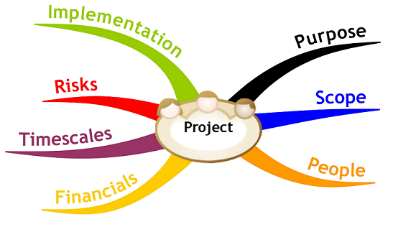
Software Project Planning [1, 2]

Slide 7



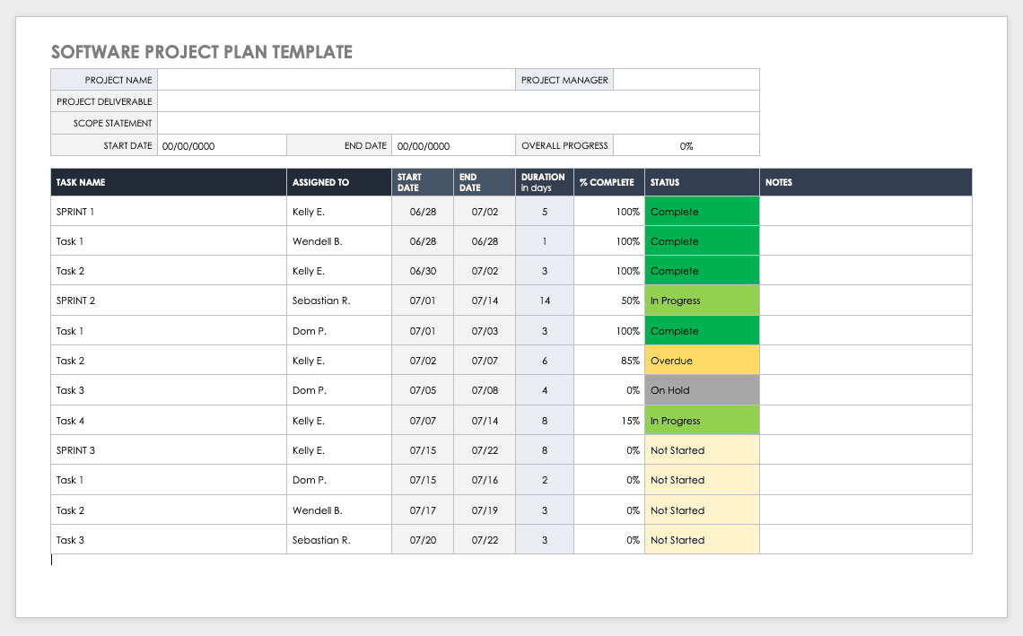
Roles and Products
System and Operations Concept Document
Project Manager
Business Analyst
Technical Architect
Clients, Users
Project Plan

Slide 8

Why Take This Step?

Slide 9
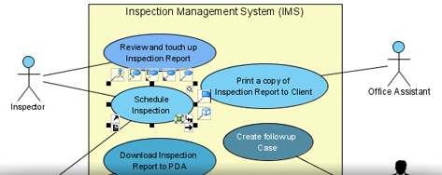
Software Requirements [3]
The elicitation, analysis, specification, and validation of requirements for software.
Requirements elicitation
Requirements analysis and negotiation
Requirements specification
System modeling
Requirements validation
Requirements management

Slide 10



Roles and Products
Glossary,
Business rules
Domain model
Project vision
Functional requirement specification
Supplementary specification
Business Analyst
Users
Project Manager
Product backlog
User stories

Slide 11
Why Take This Step?

Slide 12
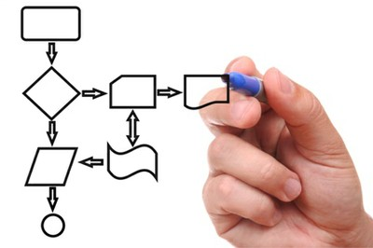
Software Design
The process of problem-solving and planning for a software solution.
After the purpose and specifications of software are determined, software developers plan for a solution.
It includes low-level component and algorithm implementation issues as well as the architectural view.

Slide 13
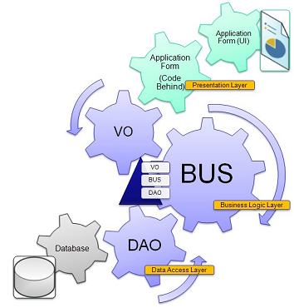
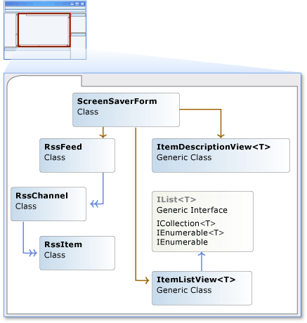

Roles and Products
GUI
Architectural design specification
Detailed design specification
Technical Architect, Designer, Developer

Slide 14
Why Take This Step?

Slide 15

Software Construction (Implementation)
The construction of software through the use of programming languages.

Slide 16
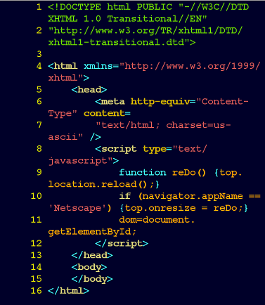
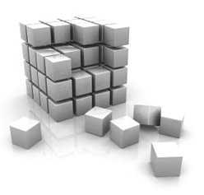



Roles and Products
Module
Product
Code File, Unit Tests
Development Plan
Integration Plan
Developer
Technical Architect

Slide 17
Why Take This Step?

Slide 18
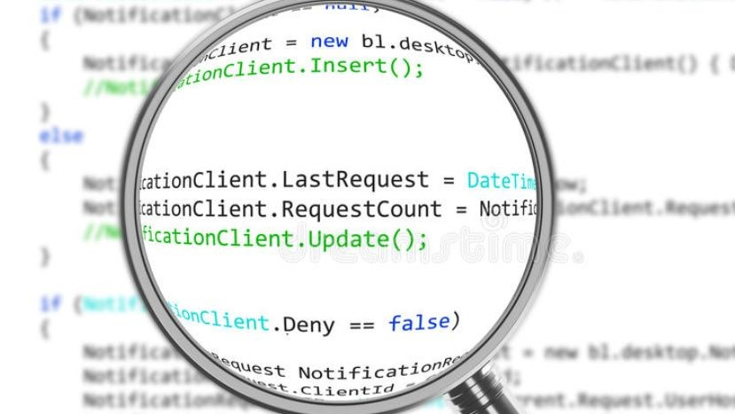
Software Inspection Roles And Products
Bugs
Code standard or convention issues
Technical Architect, Developer

Slide 19
Why Take This Step?

Slide 20
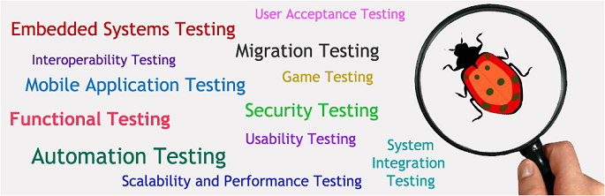
Software Testing
The empirical investigations conducted to provide stakeholders with information about the quality of the product or service under test, with respect to the context in which it is intended to operate.

Slide 21
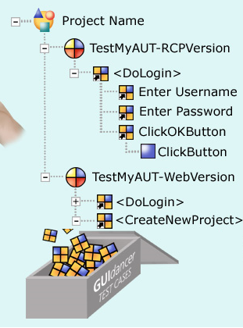

Roles and Products
Test Plan
Test Data
User Guide
Test Result
QA/QC and Tester

Slide 22
Why Take This Step?

Slide 23


Software Deployment & Acceptance Testing
Acceptance Test Plan
Test Result
System Delivery
Supporter and
Development Team
Clients, Users

Slide 24
Why Take This Step?

Slide 25

Software Operation & Maintenance
Software systems often have problems and need enhancements for a long time after they are first completed. This subfield deals with those problems.
Software maintenance is the process of enhancing and optimizing deployed software (software release), as well as remedying defects.

Slide 26

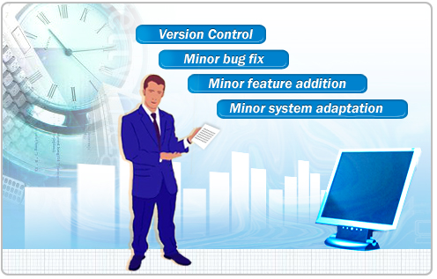
Roles and Products
Clients, Users, Supporters and Development Team

Slide 27
Why Take This Step?

Slide 28
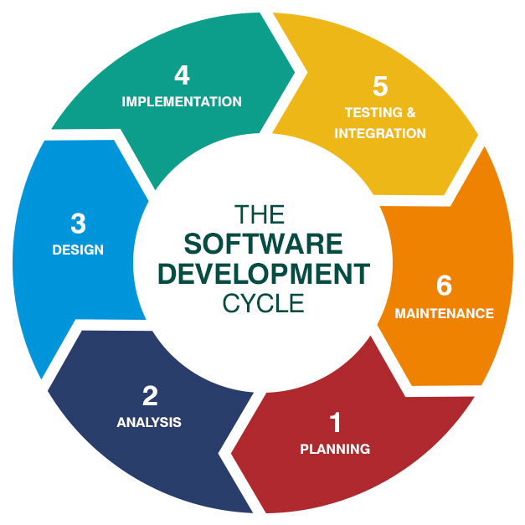
The Software Development Life Cycle [4]
Software development life cycle: all the states through which the software evolves.

Slide 29
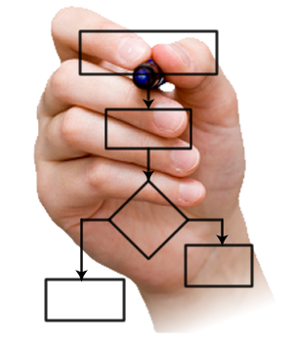
SDLC Model [2]
A software life cycle model is either a descriptive or prescriptive characterization of software evolution.
Typically, it is easier and more common to articulate a prescriptive life cycle model for how software systems should be developed.
Descriptive life cycle models, on the other hand, characterize how particular software systems are actually developed in specific settings.

Slide 30
SDLCM Elements
SDLCM
Phases
Practices
Templates
Standards
Roles
Activities
Work Products

Slide 31
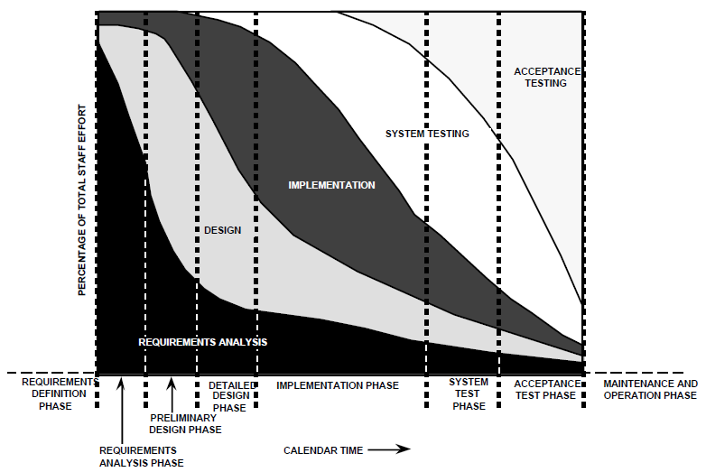
NASA/SEL SDLC Model [1]

Slide 32
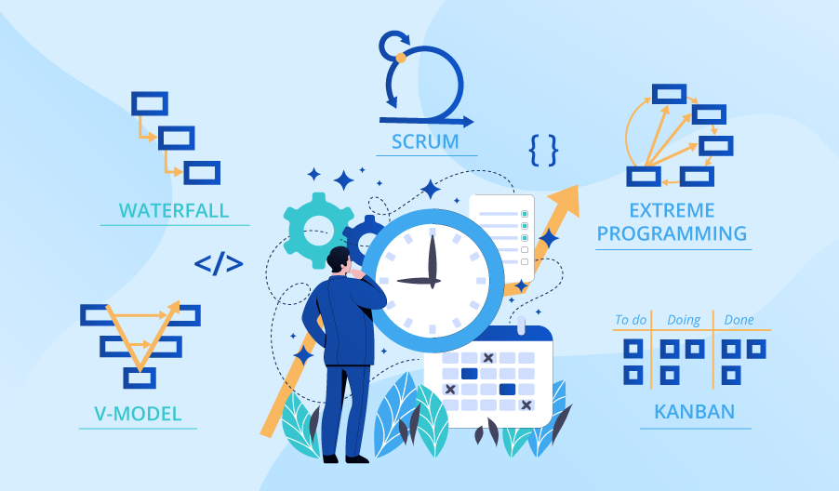
Why Learn SDLC Models?

Slide 33

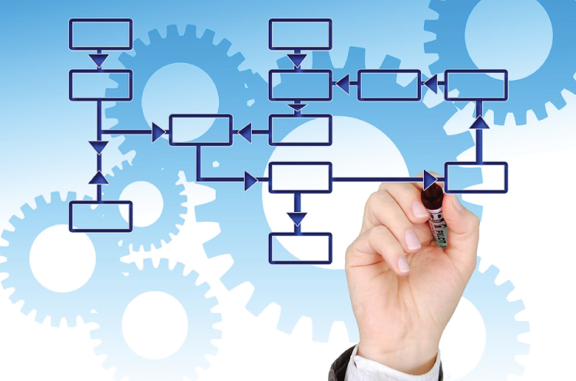
Defining a SDLC Model

Slide 34
SDLC Model Definition Template
Life cycle (hierarchical/overlapped phases)
Phase
Purpose
Entry criteria
Inputs
Roles
Tasks
Process flow
Deliverables
Checkpoints
Outputs
Exit criteria

Slide 35
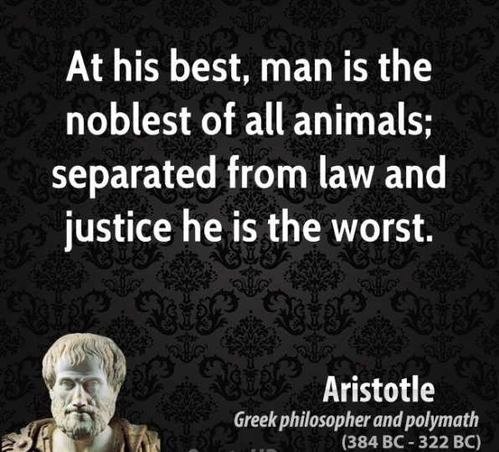

Why Define a SDLC Model? [2]
As comparative descriptive or prescriptive accounts for how software systems come to be the way they are.
Regulatory compliance.
As frameworks for analyzing or estimating patterns of resource allocation and consumption during the software life cycle.
To organize, plan, staff, budget, schedule and manage software project work over organizational time, space, and computing environments.
As a basis for conducting empirical studies to determine what affects software productivity, cost, and overall quality.
As a basis for determining what software engineering tools and methodologies will be most appropriate to support different life cycle activities.
As prescriptive outlines for what products to produce for approvals and delivery to client.
Establish a framework for building, implementing and enhancing systems that all personnel have to follow.

Slide 36
Actually, Why SDLC Model?
Well-defined model: achieving good and consistent results, productivity and quality.
ill-defined model: producing inconsistent results, overburdening team members with unnecessary documents, meetings and report requests, leading to less productivity and quality.
Is there any proof?
Productivity = Size / Effort.
Size = LOC, Classes, Methods, Features, Bugs Fixed
Effort = Time Log, Hours Billed.

Slide 37

A Way to Guarantee the Failure
Don’t use a specific methodology because coding is all that is really important.

Slide 38
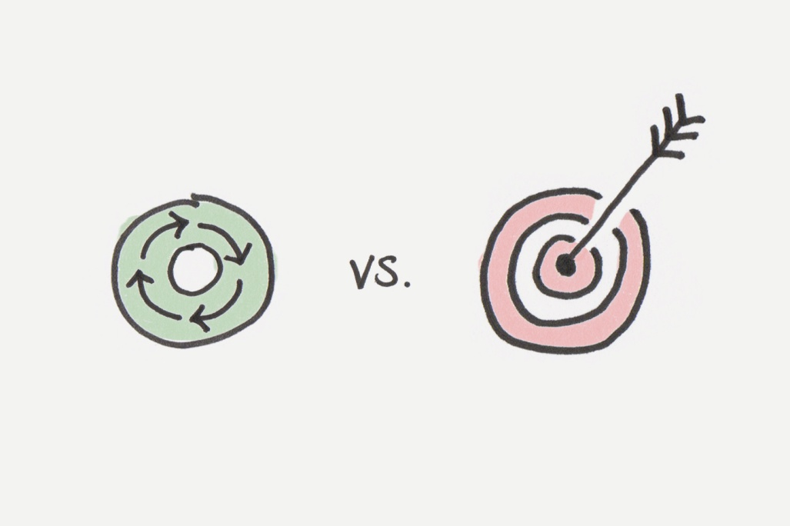
Another Way to Guarantee the Failure [5]
Well-defined roles might help those people to organize around the work, but the formation of roles is not the goal.
A checklist might help those people do the work in a way that meets the goal, but the checklist is not the goal either.
Confusing processes with the goals is one of the great sins of management.

Slide 39

Thank You & See You Again

